Slide 1
Chapter 10
Asymmetric-Key
Cryptography
10.<number>

Slide 2
10-1 INTRODUCTION
Symmetric and asymmetric-key cryptography will exist in parallel and continue to serve the community. We actually believe that they are complements of each other; the advantages of one can compensate for the disadvantages of the other.
Topics discussed in this section:
10.1.1 Keys
10.1.2 General Idea
10.1.3 Need for Both
10.1.4 Trapdoor One-Way Function
10.1.5 Knapsack Cryptosystem
10.<number>

Slide 3

10-1 INTRODUCTION
Note
Symmetric-key cryptography is based on sharing secrecy;
asymmetric-key cryptography is based on personal secrecy.
10.<number>

Slide 4
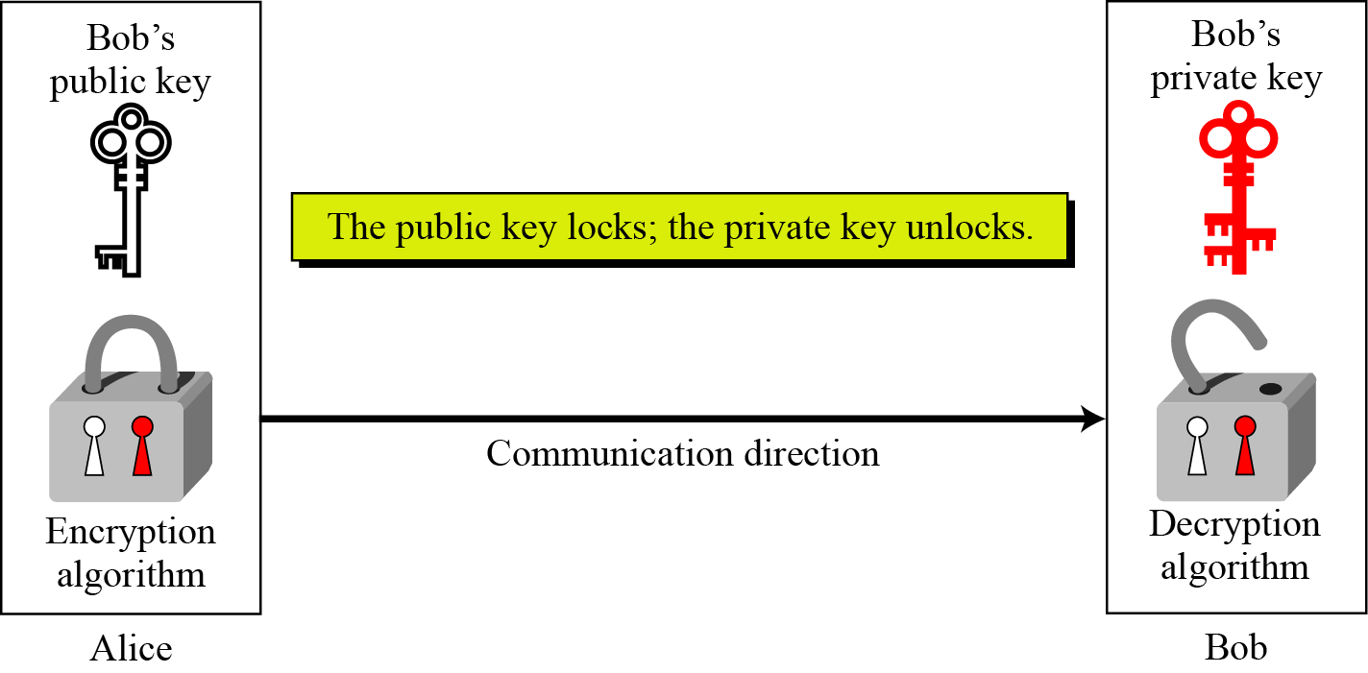
10.1.1 Keys
Asymmetric key cryptography uses two separate keys: one private and one public.
Figure 10.1 Locking and unlocking in asymmetric-key cryptosystem
10.<number>

Slide 5
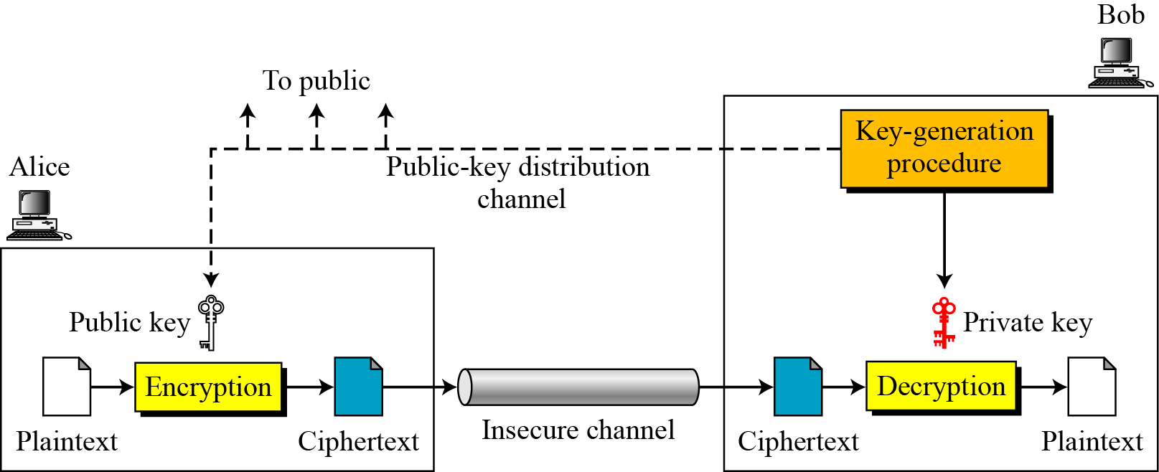
10.1.2 General Idea
Figure 10.2 General idea of asymmetric-key cryptosystem
10.<number>

Slide 6
10.1.2 Continued
Plaintext/Ciphertext
Unlike in symmetric-key cryptography, plaintext and ciphertext are treated as integers in asymmetric-key cryptography.
Encryption/Decryption
C = f (K_{public} , P) P = g(K_{private} , C)
10.<number>

Slide 7
10.1.3 Need for Both
There is a very important fact that is sometimes misunderstood: The advent of asymmetric-key cryptography does not eliminate the need for symmetric-key cryptography.
10.<number>

Slide 8
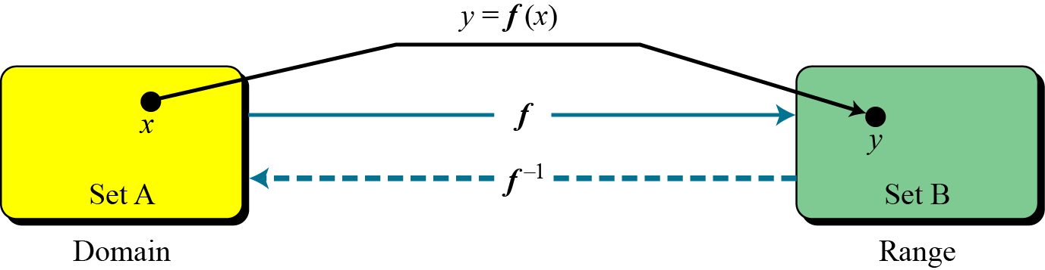
10.1.4 Trapdoor One-Way Function
The main idea behind asymmetric-key cryptography is the concept of the trapdoor one-way function.
Functions
Figure 10.3 A function as rule mapping a domain to a range
10.<number>

Slide 9
10.1.4 Continued
One-Way Function (OWF)
1. f is easy to compute.
2. f ⁻¹ is difficult to compute.
Example 10. 1
When n is large, n = p × q is a one-way function. Given p and q , it is always easy to calculate n ; given n, it is very difficult to compute p and q. This is the factorization problem.
10.<number>

Slide 10
10.1.4 Continued
Trapdoor One-Way Function (TOWF)
3. Given y and a trapdoor(secret), x can be computed easily.
Example 10. 2
When n is large, the function y = x^{k} mod n
is a trapdoor one-way function.
Given x, k, and n, it is easy to calculate y.
Given y, k, and n, it is very difficult to calculate x.
This is the discrete logarithm problem.
However, if we know the trapdoor,
k′ such that k × k ′ = 1 mod φ(n),
we can use x = y^{k′} mod n to find x.
10.<number>

Slide 11
10-2 RSA CRYPTOSYSTEM
The most common public-key algorithm is the RSA cryptosystem, named for its inventors (Rivest, Shamir, and Adleman).
Topics discussed in this section:
10.2.1 Introduction
10.2.2 Procedure
10.2.3 Some Trivial Examples
10.2.4 Attacks on RSA
10.2.5 Recommendations
10.2.6 Optimal Asymmetric Encryption Padding (OAEP)
10.2.7 Applications
10.<number>

Slide 12
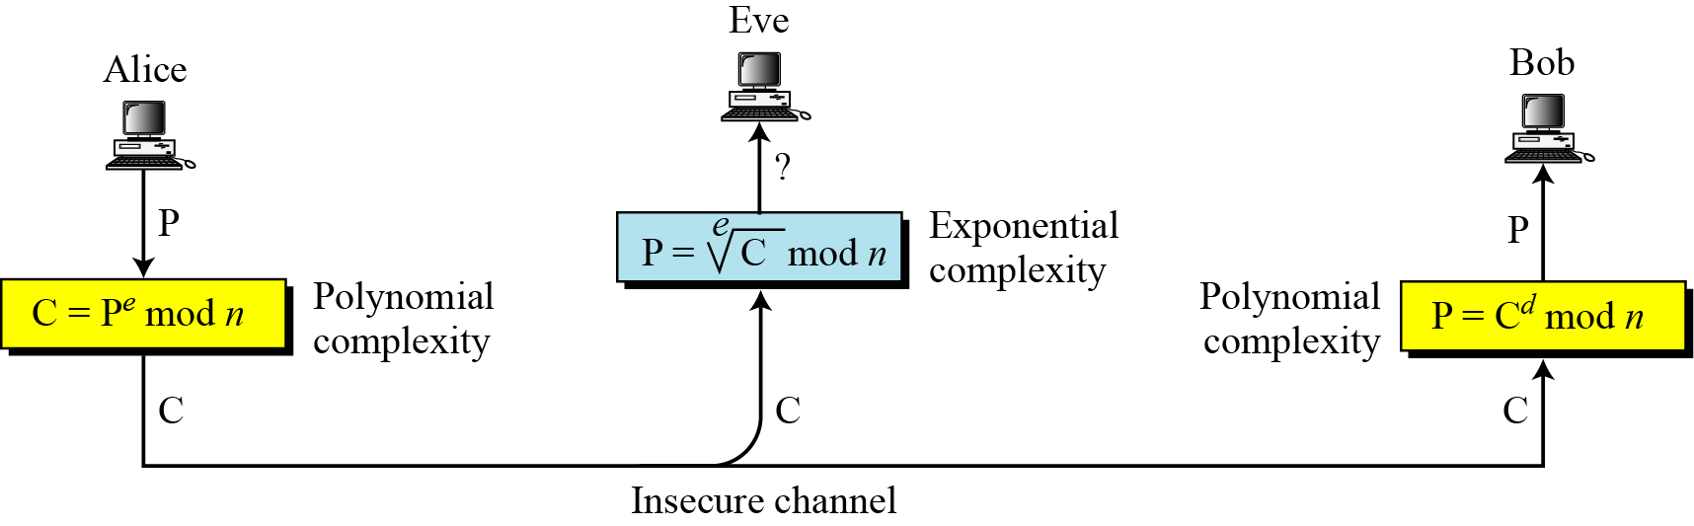
10.2.1 Introduction
Figure 10.5 Complexity of operations in RSA
10.<number>

Slide 13
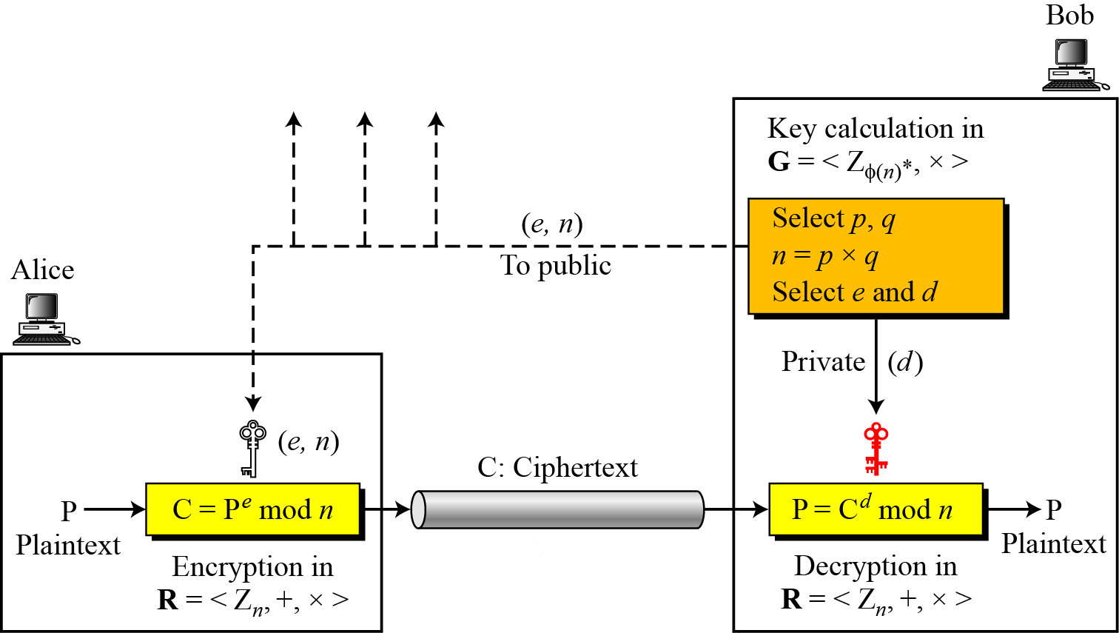
10.2.2 Procedure
Figure 10.6 Encryption, decryption, and key generation in RSA
10.<number>

Slide 14
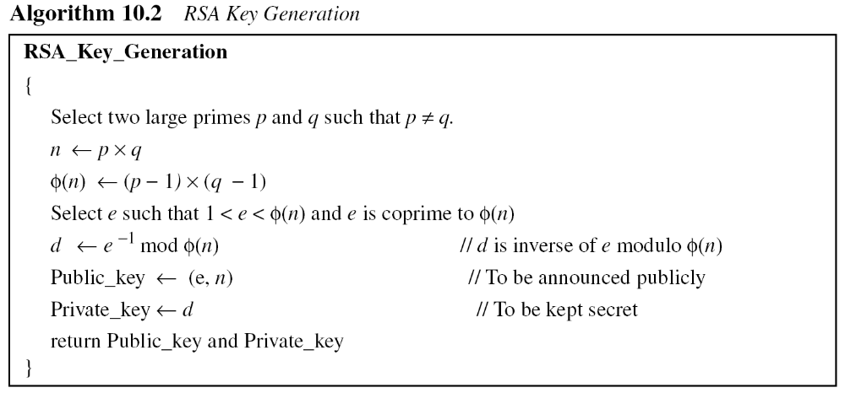
10.2.2 Continued
10.<number>

Slide 15
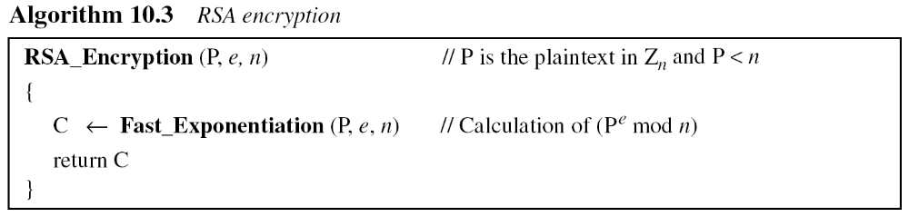
10.2.2 Continued
Encryption
10.<number>

Slide 16
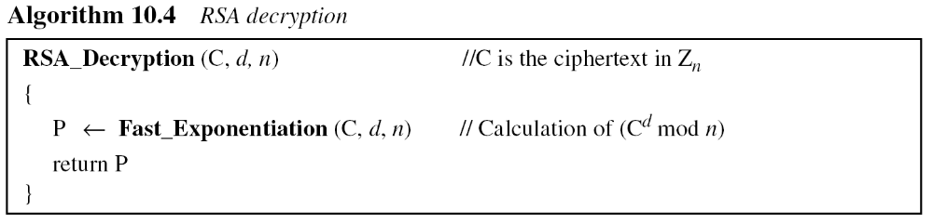
10.2.2 Continued
Decryption
10.<number>

Slide 17
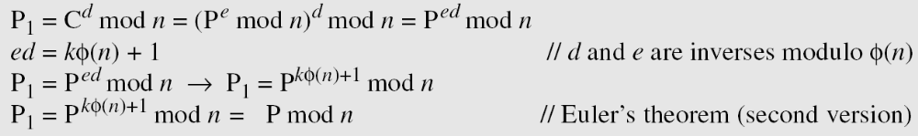
10.2.2 Continued
Proof of RSA
10.<number>

Slide 18
10.2.3 Some Trivial Examples
Example 10. 5
Bob chooses 7 and 11 as p and q and calculates n = 77. The value of φ(n) = (7 − 1)(11 − 1) or 60. Now he chooses two exponents, e and d, from Z₆₀∗. If he chooses e to be 13, then d is 37. Note that e × d mod 60 = 1 (they are inverses of each Now imagine that Alice wants to send the plaintext 5 to Bob. She uses the public exponent 13 to encrypt 5.
Bob receives the ciphertext 26 and uses the private key 37 to decipher the ciphertext:
10.<number>

Slide 19
10.2.3 Some Trivial Examples
Example 10. 6
Now assume that another person, John, wants to send a message to Bob. John can use the same public key announced by Bob (probably on his website), 13; John’s plaintext is 63. John calculates the following:
Bob receives the ciphertext 28 and uses his private key 37 to decipher the ciphertext:
10.<number>

Slide 20
10.2.3 Some Trivial Examples
Example 10. 7
Jennifer creates a pair of keys for herself. She chooses p = 397 and q = 401. She calculates
n = 159197. She then calculates φ(n) = 158400. She then chooses e = 343 and d = 12007. Show how Ted can send a message to Jennifer if he knows e and n.
Suppose Ted wants to send the message “NO” to Jennifer. He changes each character to a number (from 00 to 25), with each character coded as two digits. He then concatenates the two coded characters and gets a four-digit number. The plaintext is 1314. Figure 10.7 shows the process.
10.<number>

Slide 21
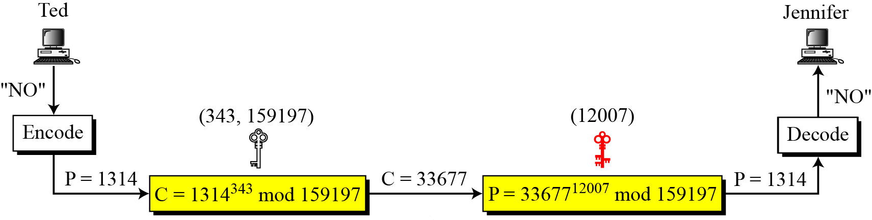
10.2.3 Continued
Figure 10.7 Encryption and decryption in Example 10.7
10.<number>

Slide 22
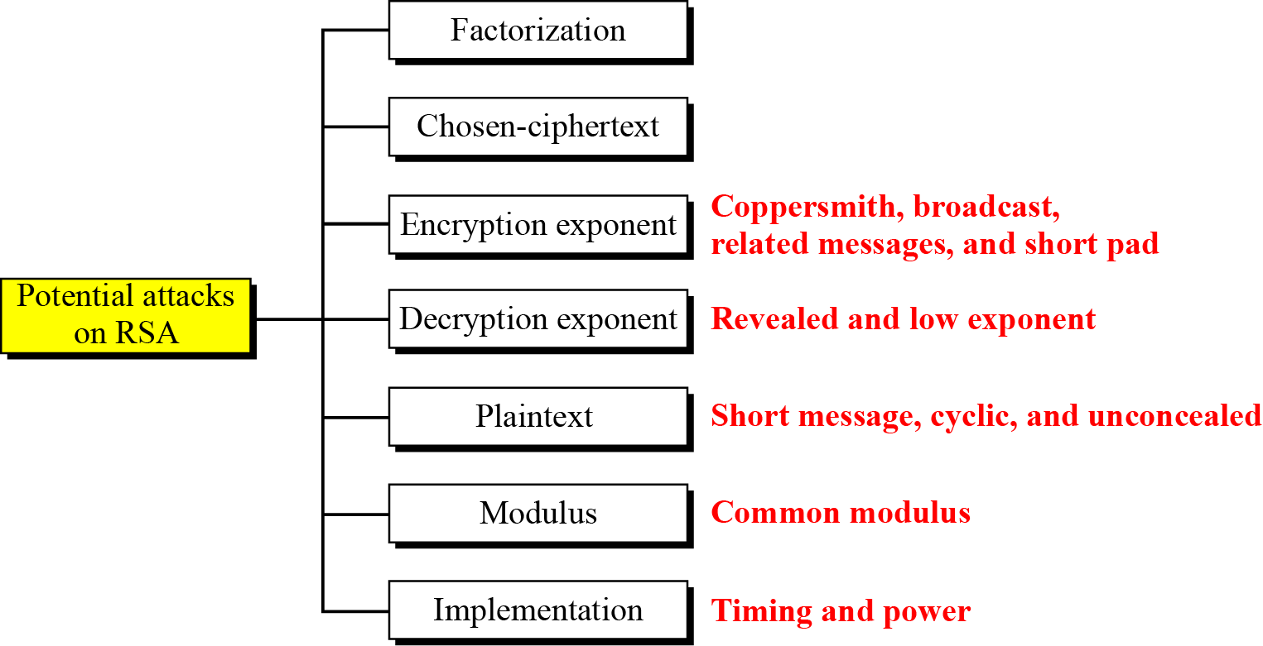
10.2.4 Attacks on RSA
Figure 10.8 Taxonomy of potential attacks on RSA
Coppersmith method for attacking RSA include cases when the public exponent e is small or when partial knowledge of the secret key is available.
10.<number>

Slide 23
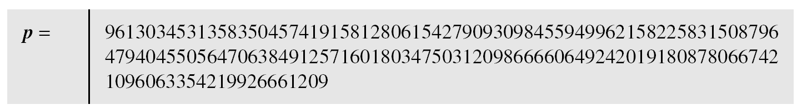
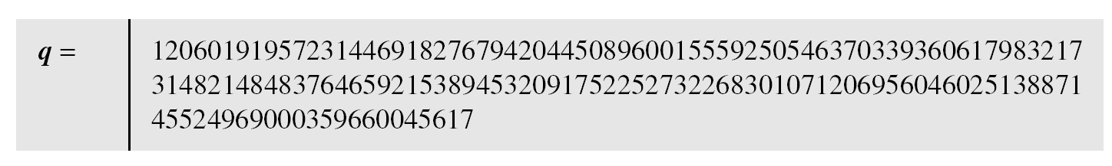
10.2.6 Continued
Example 10. 8
Here is a more realistic example. We choose a 512-bit p and q, calculate n and φ(n), then choose e and test for relative primeness with φ(n). We then calculate d. Finally, we show the results of encryption and decryption. The integer p is a 159-digit number.
10.<number>

Slide 24
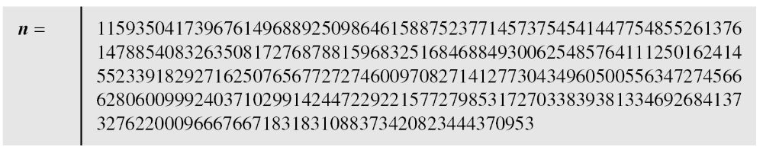
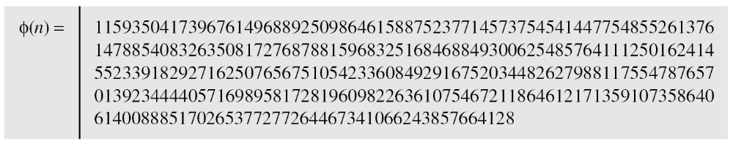
10.2.6 Continued
Example 10. 8
Continued
The modulus n = p × q. It has 309 digits.
φ(n) = (p − 1)(q − 1) has 309 digits.
10.<number>

Slide 25
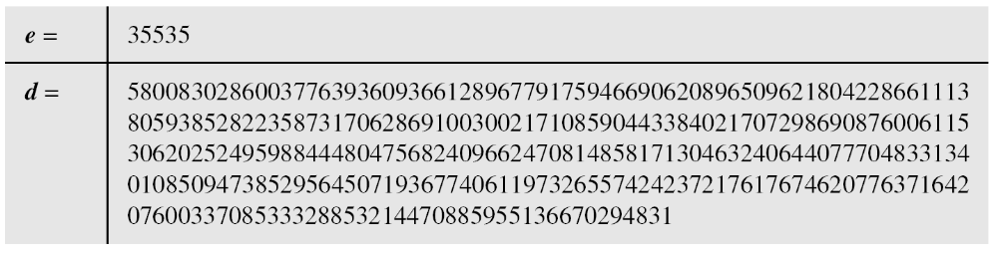
10.2.6 Continued
Example 10. 8
Continued
Bob chooses e = 35535 (the ideal is 65537) and tests it to make sure it is relatively prime with φ(n). He then finds the inverse of e modulo φ(n) and calls it d.
10.<number>

Slide 26
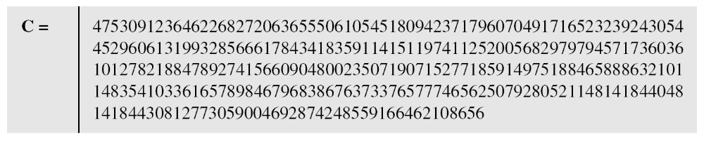
10.2.6 Continued
Example 10. 8
Continued
Alice wants to send the message “THIS IS A TEST”, which can be changed to a numeric value using the 00−26 encoding scheme (26 is the space character).
The ciphertext calculated by Alice is C = P^{e}, which is
10.<number>

Slide 27
10.2.6 Continued
Example 10. 8
Continued
Bob can recover the plaintext from the ciphertext using P = C^{d}, which is
The recovered plaintext is “THIS IS A TEST” after decoding.
10.<number>

Slide 28
Continued
Problem:1.
Given, p=5, q=11, e=3, m=9.
Perform encryption and decryption
Problem:2.
Given, n=77, e=7, Find d ?
The ciphertext = 5, find the plaintext?
43
26
10.<number>

Slide 29
10-3 RABIN CRYPTOSYSTEM
The Rabin cryptosystem can be thought of as an RSA cryptosystem in which the value of e and d are fixed.
The encryption is
C ≡ P² (mod n)
and the decryption is
P ≡ C^{1/2} (mod n).
Topics discussed in this section:
10.3.1 Procedure
10.3.2 Security of the Rabin System
10.<number>

Slide 30
Computationally secure against a chosen
plaintext attack
– Provided that the modulus n = p.q can not be factored.
n is the public key.
The primes p and q are the private key.
Choose to simplify the computation of square roots modulo p and q
10.<number>

Slide 31
B encrypts a message m and sends the
ciphertext c to A
• Encryption:
– Obtain A’s public key n.
– Represent the message as an integer m in the range {0, 1, . . . ,n-1}.
– Compute C ≡ P² (mod n)
– Send the ciphertext c to A
10.<number>

Slide 32
• A decrypts the ciphertext c as follows:
Decryption:
– Compute P ≡ C^{1/2} (mod n)
– There are four square roots m1, m2, m3,m4
of c modulo n.
– The message m is equal to one of these four messages
10.<number>

Slide 33
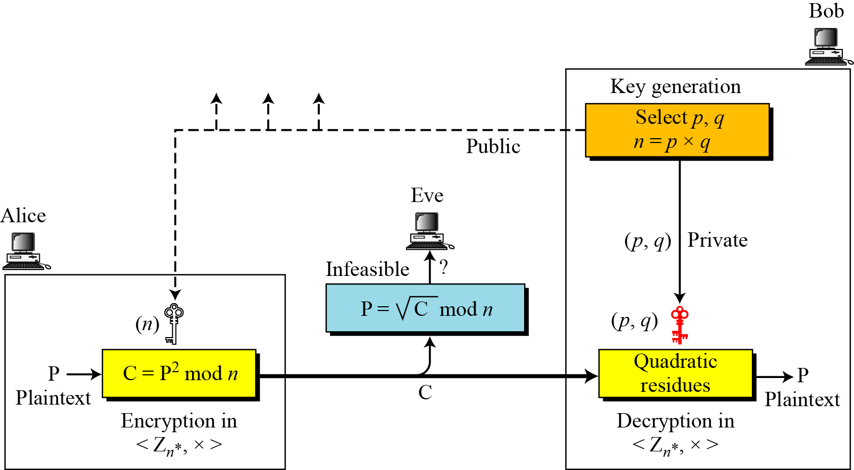
10-3 Continued
Figure 10.10 Rabin cryptosystem
10.<number>

Slide 34
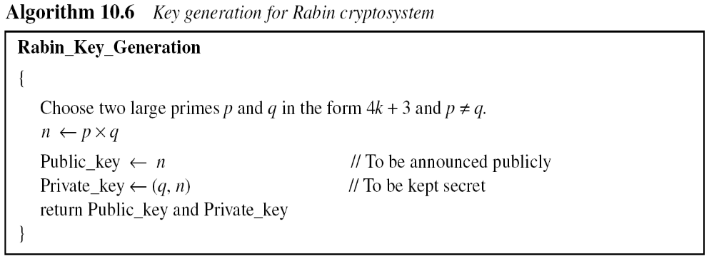
10.3.1 Procedure
Key Generation
10.<number>

Slide 35
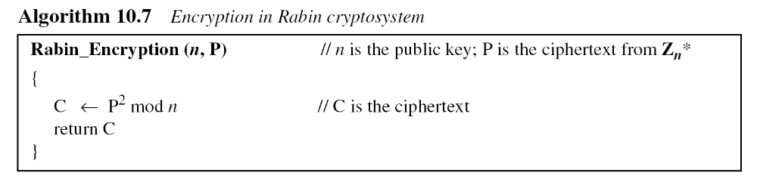
10.3.1 Continued
Encryption
10.<number>

Slide 36
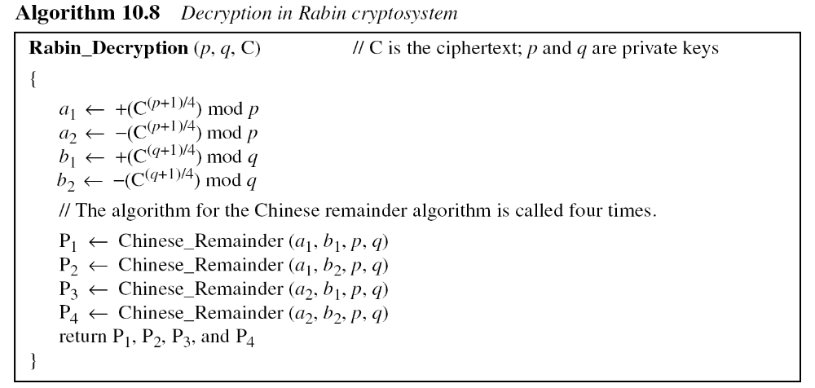
Decryption
Note
The Rabin cryptosystem is not deterministic: Decryption creates four plaintexts.
10.<number>

Slide 37
10.3.1 Continued
Example 10. 9
Here is a very trivial example to show the idea.
Bob selects p = 23 and q = 7. Note that both are
congruent to 3 mod 4.
Bob calculates n = p × q = 161.
Bob announces n publicly; he keeps p and q private.
Alice wants to send the plaintext P = 24. Note that 161 and 24 are relatively prime; 24 is in Z₁₆₁*.
She calculates C = 24² = 93 mod 161,
and sends the ciphertext 93 to Bob.
10.<number>

Slide 38
10.3.1 Continued
Example 10. 9
Bob receives 93 and calculates four values:
a₁ = +(93 ^{(23+1)/4}) mod 23 = 1 mod 23
a₂ = −(93 ^{(23+1)/4}) mod 23 = 22 mod 23
b₁ = +(93 ^{(7+1)/4}) mod 7 = 4 mod 7
b₂ = −(93 ^{(7+1)/4}) mod 7 = 3 mod 7
Bob takes four possible answers,
(a₁, b₁), (a₁, b₂), (a₂, b₁), and (a₂, b₂),
and uses the Chinese remainder theorem to find four possible plaintexts: 116, 24, 137, and 45.
Note that only the second answer is Alice’s plaintext.
10.<number>

Slide 39
CHINESE REMAINDER THEOREM
It is possible to reconstruct integers in a certain range from their residues modulo, a set of pairwise relatively prime moduli.
10.<number>

Slide 40
A Simple Example of redundancy:
a real example would use primes in the range
from 512 to 1024 bits long, just as in the case of RSA.
Say, p = 7, q = 11, and n = 77.
Then (-3)*7 + 2*11 = 1, so that a = -3 and b = 2.
Suppose one uses 3-bit messages whose bits are then replicated to give 6 bits,
up to the number 63. Messages must be in the range from 1 to 70,
so this system of redundancy will work.
Start with data bits 101₂ or 5₁₀.
The replication gives 101101₂ or 45₁₀. Then c = m² mod 77 = 23.
Continuing the calculations, r = 23² mod 7 = 4, and s = 23³ mod 11 = 1.
Finally, x = ((-3)*7*1 + 2*11*4) mod 77 = 67
And y = ((-3)*7*1 - 2*11*4) mod 77 = 45.
These are two of the four square roots, and the remaining two are -x mod 77 = 10
and -y mod 77 = 32. In binary, the four square roots are 67 = 1000011₂,
45 = 101101₂, 10 = 001010₂, and 32 = 100000₂.
Only 45 has the required redundancy, so this is the only number that this modified
Rabin machine will return.
10.<number>

Slide 41
Effectiveness:
Decoding produces three false results in addition to the correct one, so that the correct result must be guessed. This is the major disadvantage of the Rabin cryptosystem and one of the factors which have prevented it from finding widespread practical use.
If the plaintext is intended to represent a text message, guessing is not difficult; however, if the plaintext is intended to represent a numerical value, this issue becomes a problem that must be resolved by some kind of disambiguation scheme. It is possible to choose plaintexts with special structures, or to add padding to eliminate this problem. The most common way of implementing disambiguation is known as Blum disambiguation. Disambiguation introduces additional computational costs, and is what has prevented the Rabin cryptosystem from finding widespread practical use.
10.<number>

Slide 42
Security
The great advantage of the Rabin cryptosystem is that the code can only be broken if the codebreaker is capable of efficiently factoring the public key n.
It has been proven that decoding the Rabin cryptosystem is equivalent to the factorization problem, unlike in RSA.
Thus the Rabin system is more secure than RSA, and will remain so until a general solution for the factorization problem is discovered.
10.<number>

Slide 43
Discrete logarithm problem:
Let ‘a’ be a primitive root of a prime no. p, as one whose powers generate all integers from 1 to p-1.
i.e. a mod p,
a² mod p,
… …
a^{p-1} mod p .
are distinct and consists of integers from 1 to p-1.
For any integer b , we can find a unique exponent i s.t. b ≡ a^{i} mod p
    exponent i is the discrete logarithm
    Ex: 2 is a primitive root of 11.
10.<number>

Slide 44
10-4 ELGAMAL CRYPTOSYSTEM
Besides RSA and Rabin,
another public-key cryptosystem is ElGamal.
ElGamal is based on the discrete logarithm problem.
i.e. given e2, e1 and p , it is infeasible to calculate r = log_{e1}e₂ mod p
10.<number>

Slide 45
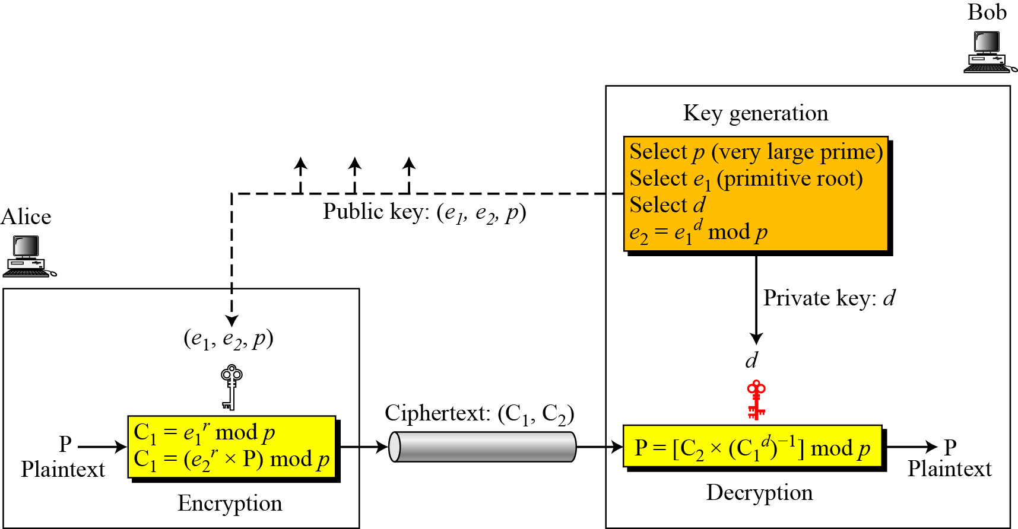
10.4.2 Procedure
Figure 10.11 Key generation, encryption, and decryption in ElGamal
2
10.<number>

Slide 46
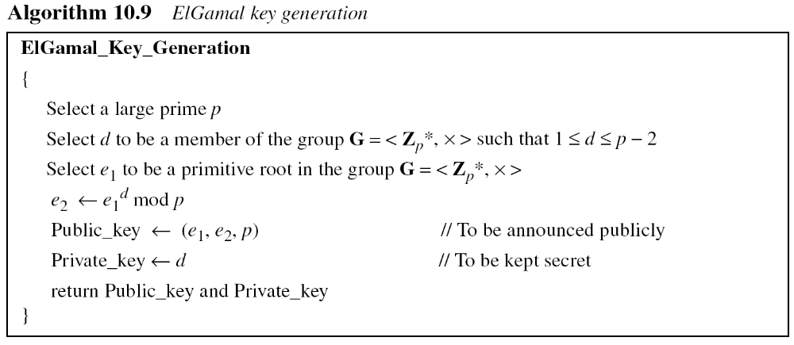
10.4.2 Continued
Key Generation
10.<number>

Slide 47
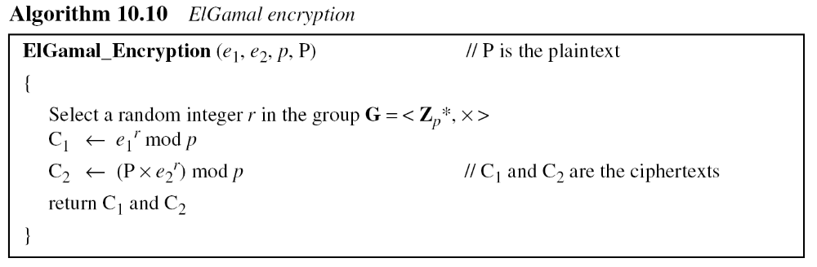
10.4.2 Continued
10.<number>

Slide 48
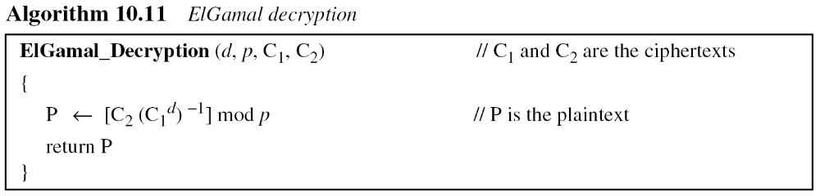
10.4.2 Continued
Note
The bit-operation complexity of encryption or decryption in ElGamal cryptosystem is polynomial.
10.<number>

Slide 49
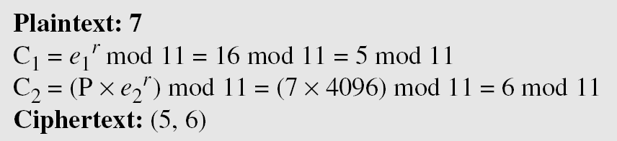
10.4.3 Continued
Example 10. 10
Here is a trivial example. Bob chooses p = 11 and e₁ = 2.
and d = 3 e₂ = e₁^{d} = 8. So the public keys are (2, 8, 11) and the private key is 3. Alice chooses r = 4 and calculates C1 and C2 for the plaintext 7.
Bob receives the ciphertexts (5 and 6) and calculates the plaintext.
10.<number>

Slide 50
10.4.3 Continued
Example 10. 11
Instead of using P = [C₂ × (C₁^{d}) ⁻¹] mod p for decryption, we can avoid the calculation of multiplicative inverse and use
P = [C₂ × C₁ ^{p−1−d}] mod p (see Fermat’s little theorem in Chapter 9). In Example 10.10, we can calculate P = [6 × 5 ¹¹⁻¹⁻³] mod 11
= 7 mod 11.
Note
For the ElGamal cryptosystem, p must be at least 300 digits and r must be new for each encipherment.
10.<number>

Slide 51
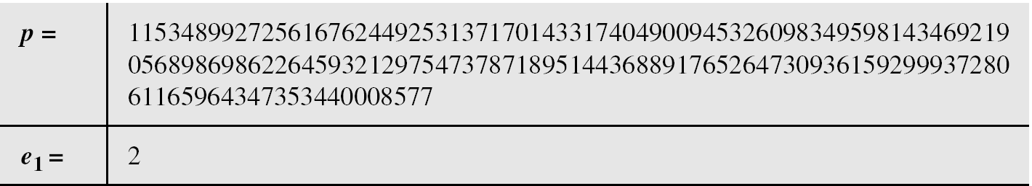
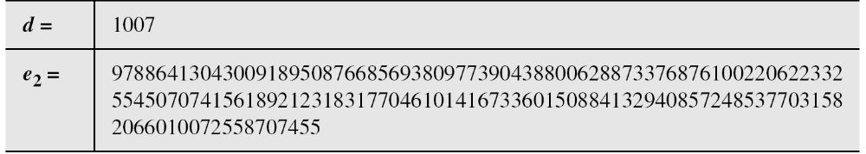
10.4.3 Continued
Example 10. 12
Bob uses a random integer of 512 bits. The integer p is a 155-digit number (the ideal is 300 digits). Bob then chooses e₁, d, and calculates e₂, as shown below:
10.<number>

Slide 52
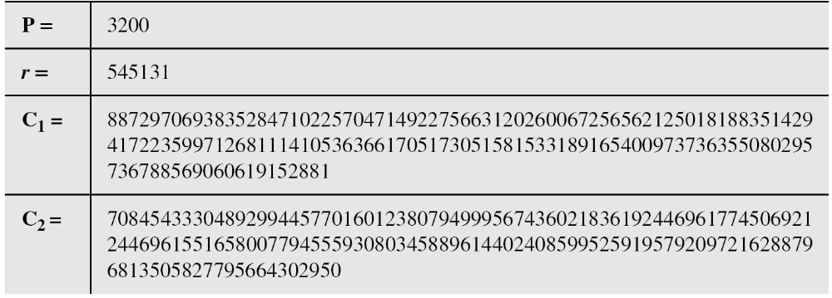
10.4.3 Continued
Example 10. 10
Alice has the plaintext P = 3200 to send to Bob. She chooses
r = 545131, calculates C1 and C2, and sends them to Bob.
Bob calculates the plaintext P = C₂ × ((C₁)^{d})⁻¹ mod p = 3200 mod p.
10.<number>

Slide 53
10-5 ELLIPTIC CURVE CRYPTOSYSTEMS
Although RSA and ElGamal are secure asymmetric-key cryptosystems, their security comes with a price, their large keys. Researchers have looked for alternatives that give the same level of security with smaller key sizes. One of these promising alternatives is the elliptic curve cryptosystem (ECC).
Topics discussed in this section:
10.5.1 Elliptic Curves over Real Numbers
10.5.2 Elliptic Curves over GF( p)
10.5.3 Elliptic Curves over GF(2^{n})
10.5.4 Elliptic Curve Cryptography Simulating ElGamal
10.<number>

Slide 54

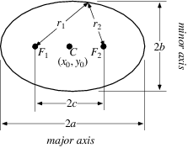
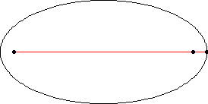
Ellipse
The equation of an ellipse in Cartesian coordinates is:
10.<number>

Slide 55
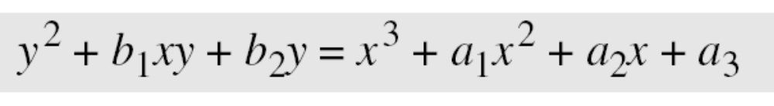
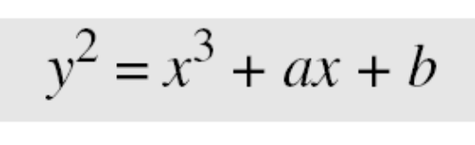
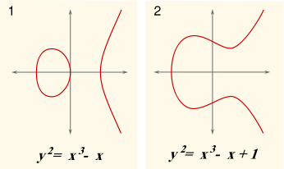
10.5.1 Elliptic Curves over Real Numbers
An elliptic curve is a plane curve which consists of the points satisfying the equation. The general equation for an elliptic curve is
Elliptic curves over real numbers use a special class of elliptic curves of the form
10.<number>

Slide 56
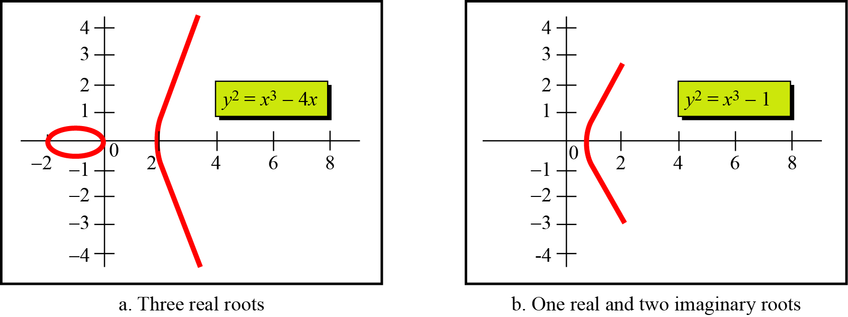
Example 10. 13
Figure 10.12 shows two elliptic curves with equations y² = x³ − 4x and y² = x³ − 1. Both are nonsingular. However, the first has three real roots (x = −2, x = 0, and x = 2), but the second has only one real root (x = 1) and two imaginary ones.
Figure 10.12 Two elliptic curves over a real field
10.<number>

Slide 57
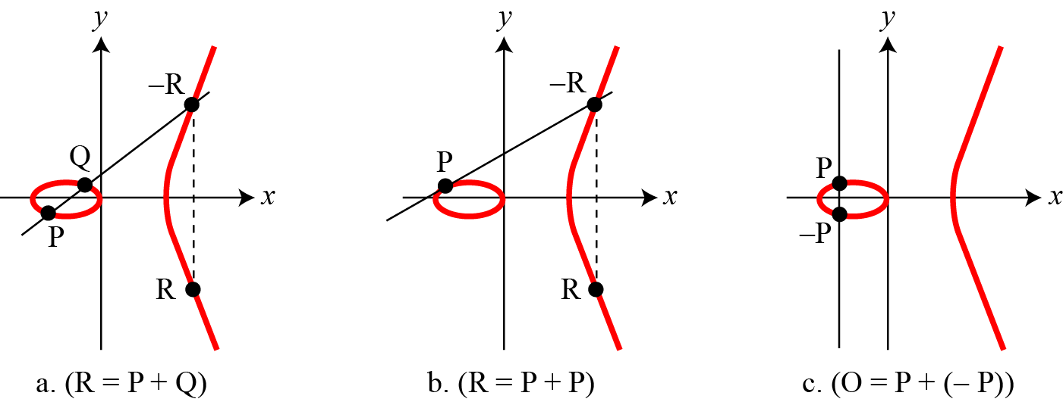
An Abelian Group
Define a point P=(x₁,y₁) on the elliptic curve and a group of such points, Q =(x₂,y₂) , R =(x₃,y₃) etc. forms an Abelian Group that allows addition operation.
i.e. G = <E,+> Where E={ (2.0,0.0), (0.0,0.0), (-2.0,0.0), (10.0,30.98)
Figure 10.13 Three adding cases in an elliptic curve
The line connecting P and Q intercepts the curve at –R.
R is the reflection of –R.
10.<number>

Slide 58
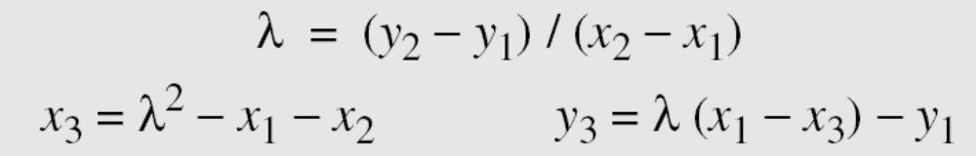
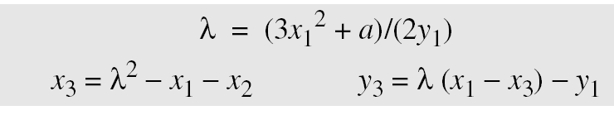
10.5.1 Continued
The slope of the line λ
1.
2.
3. The intercepting point is at infinity; a point O as the point at infinity or zero point, which is the additive identity of the group.
10.<number>

Slide 59
Curves and Key Length
ECC keys have length, which directly depends
on the underlying curve. In most applications
(like OpenSSL, OpenSSH and Bitcoin) the
default key length for the ECC private keys is
256 bits, but depending on the curve many
different ECC key sizes are possible: 192-bit
(curve secp192r1), 233-bit (curve sect233k1),
224-bit (curve secp224k1),
256-bit (curves secp256k1 and Curve25519),
283-bit (curve sect283k1),
384-bit (curves p384 and secp384r1),
409-bit (curve sect409r1),
414-bit (curve Curve41417),
448-bit (curve Curve448-Goldilocks),
511-bit (curve M-511), 521-bit (curve P-521),
571-bit (curve sect571k1) and many others.
10.<number>

Slide 60
ECC Algorithms
Elliptic-curve cryptography (ECC) provides several groups of algorithms, based on the math of the elliptic curves over finite fields:
ECC digital signature algorithms like ECDSA (for classical curves) and EdDSA (for twisted Edwards curves).
ECC encryption algorithms and hybrid encryption schemes like the ECIES integrated encryption scheme and EEECC (EC-based ElGamal).
ECC key agreement algorithms like ECDH, X25519 and FHMQV.
10.<number>

Slide 61
Security rely upon the difficulty of the ECDLP (elliptic curve discrete logarithm problem).
All these algorithms use public / private key pairs, where the private key is an integer and the public key is a point on the elliptic curve (EC point).
In ECC we have Еlliptic curve (EC) over finite field 𝔽p
G = generator point (fixed constant, a base point on the EC)
k = private key (integer)
P = public key (point)
        P = k * G (very fast to calculate)
        k = P / G (extremely slow, considered infeasible for large k) to calculate)
        known as the ECDLP problem
10.<number>

Slide 62
ECC and Safe Curve
Eq -> y^2 = x^3 + ax + b
NIST P-256 | y^2 = x^3 - 3x + 41058363725152142129326129780047268409114441015993725554835256314039467401291
Base Point | (4843956129390645175905258525279791420276294952604174799584408071708240463528636134250956749795798585127919587881956611106672985015071877198253568414405109) = (0x6b17d1f2e12c4247f8bce6e563a440f277037d812deb33a0f4a13945d898c2960x4fe342e2fe1a7f9b8ee7eb4a7c0f9e162bce33576b315ececbb6406837bf51f5)
10.<number>

Slide 63
Multiplication of EC Points - Example in Python
use the Python library tinyec
pip install tinyec
Example y2 ≡ x3 + 7 (mod 17)
from tinyec.ec import SubGroup, Curve
field = SubGroup(p=17, g=(15, 13), n=18, h=1)
curve = Curve(a=0, b=7, field=field, name='p1707')
print('curve:', curve)
for k in range(0, 25):
p = k * curve.g
print(f"{k} * G = ({p.x}, {p.y})")
10.<number>

Slide 64
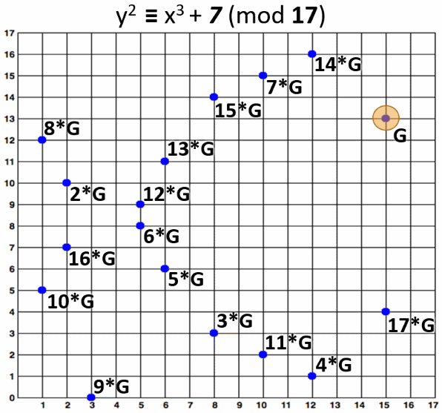
10.<number>

Slide 65
10.5.2 Elliptic Curves over GF( p) (Galois Fields)
Define an elliptic curve Group with addition operation over the GF(p) Field as Ep(a, b)
where p defines the modulus
and a and b the coefficients of the equation y²=x³+a.x+b
The field defines the add, sub, mult, division operations on real numbers that are needed to find the addition of the points in the group.
Finding an Inverse
The inverse of a point (x, y) is (x, −y),
where −y is the additive inverse of y.
For example, if p = 13, the inverse of (4, 2) is (4, 11).
10.<number>

Slide 66
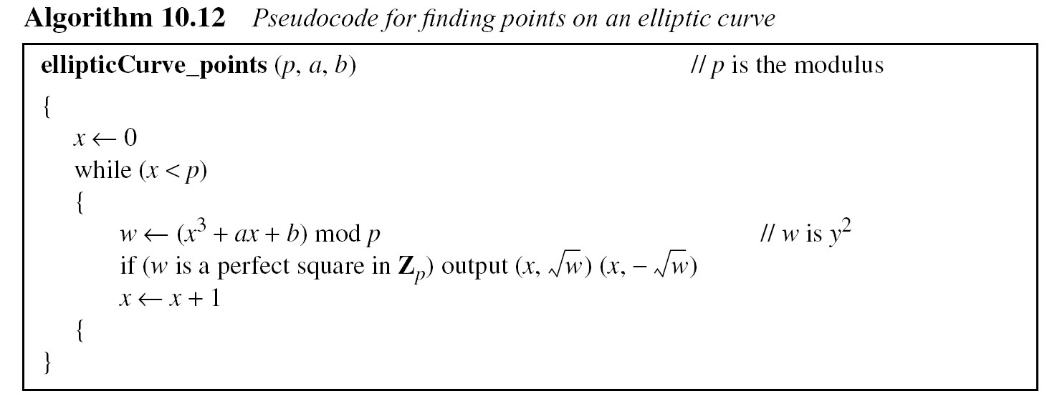
10.5.2 Continued
Finding Points on the Curve
Algorithm 10.12 shows the pseudocode for finding the points on the curve Ep(a, b).
10.<number>

Slide 67
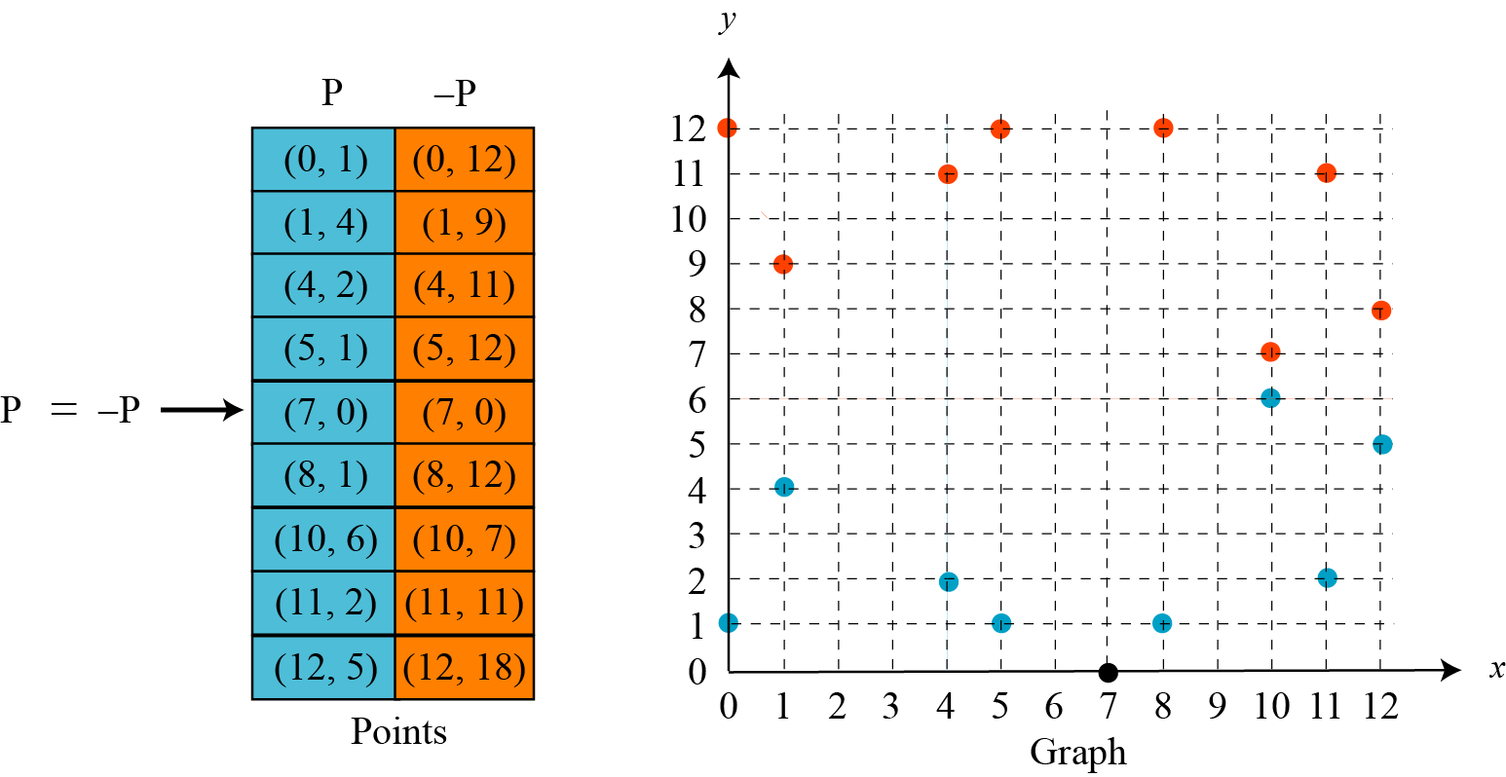
Example 10. 14
Ex: E₁₃(1,1) i.e. The equation is y² = x³ + x + 1
and the calculation is done modulo 13.
Figure 10.14 Points on an elliptic curve over GF(p)
10.<number>

Slide 68
10.5.2 Continued
Example 10. 15
Let us add two points in Example 10.14, R = P + Q,
where
P = (4, 2) and Q = (10, 6).
a. λ = (6 − 2) × (10 − 4)⁻¹ mod 13 = 4 × 6⁻¹ mod 13 = 5 mod 13.
b. x = (5² − 4 −10) mod 13 = 11 mod 13.
c. y = [5 (4 −11) − 2] mod 13 = 2 mod 13.
d. R = (11, 2), which is a point on the curve in Example 10.14.
10.<number>

Slide 69
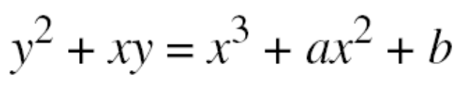
10.5.3 Elliptic Curves over GF(2^{n})
To define an elliptic curve over GF(2^{n}) Field, ( the elements of the field are the set of n-bit words) one needs to change the cubic equation. The common equation is
10.<number>

Slide 70
10.5.3 Continued
Finding Inverses
If P = (x, y), then −P = (x, x + y).
Finding Points on the Curve
We can write an algorithm to find the points on the curve using generators for polynomials discussed in Chapter 7. This algorithm is left as an exercise. Following is a very
trivial example.
10.<number>

Slide 71
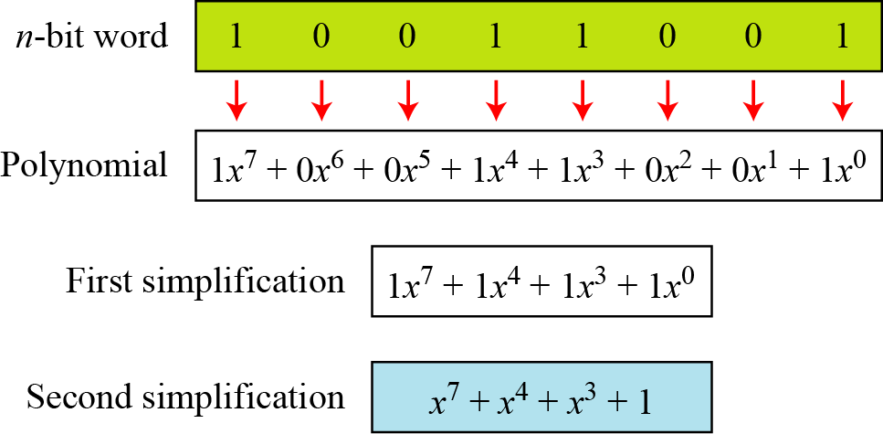
Figure 4.9 show how we can represent the 8-bit word (10011001) using a polynomials.
Figure 4.9 Representation of an 8-bit word by a polynomial
10.<number>

Slide 72

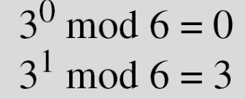
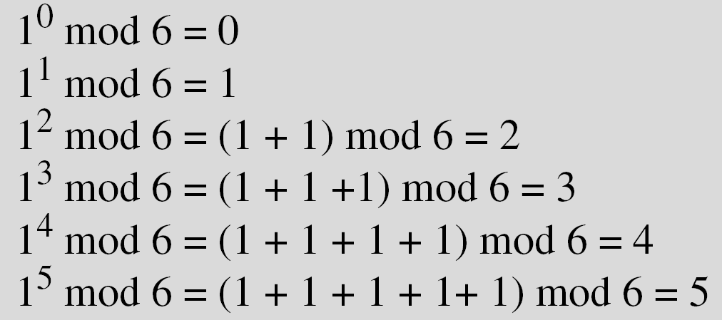
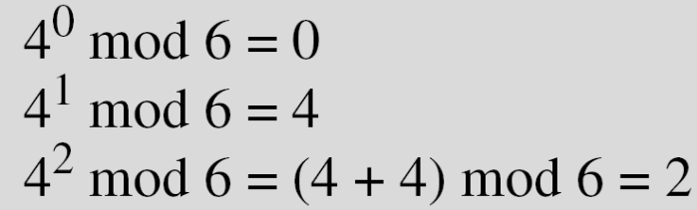
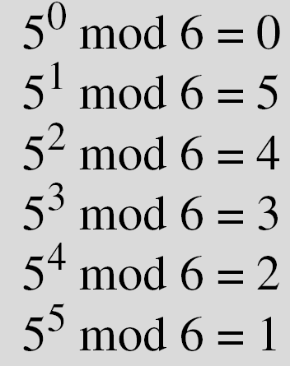
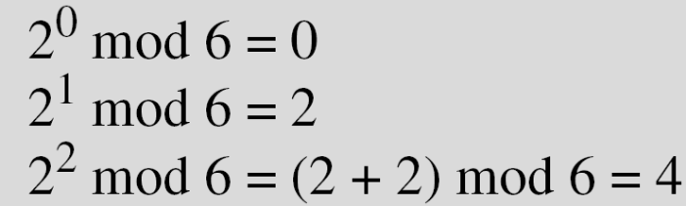
Example 4.7
Four cyclic subgroups can be made from the group
G = <Z6, +>. They are H1 = <{0}, +>, H2 = <{0, 2, 4}, +>,
H₃ = <{0, 3}, +>, and H4 = G.
10.<number>

Slide 73
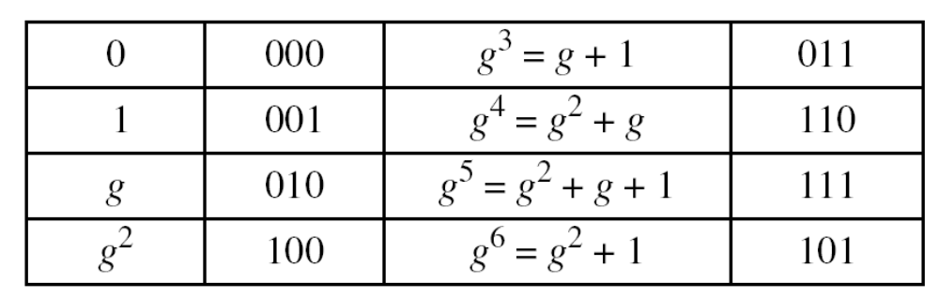
10.5.3 Continued
Example 10. 16
We choose GF(2³) with elements {0, 1, g, g², g³, g⁴, g⁵, g⁶} using the irreducible polynomial of f(x) = x³ + x + 1, which means that
g³ + g + 1 = 0 or g³ = g + 1. Other powers of g can be calculated
accordingly. The following shows the values of the g’s.
10.<number>

Slide 74
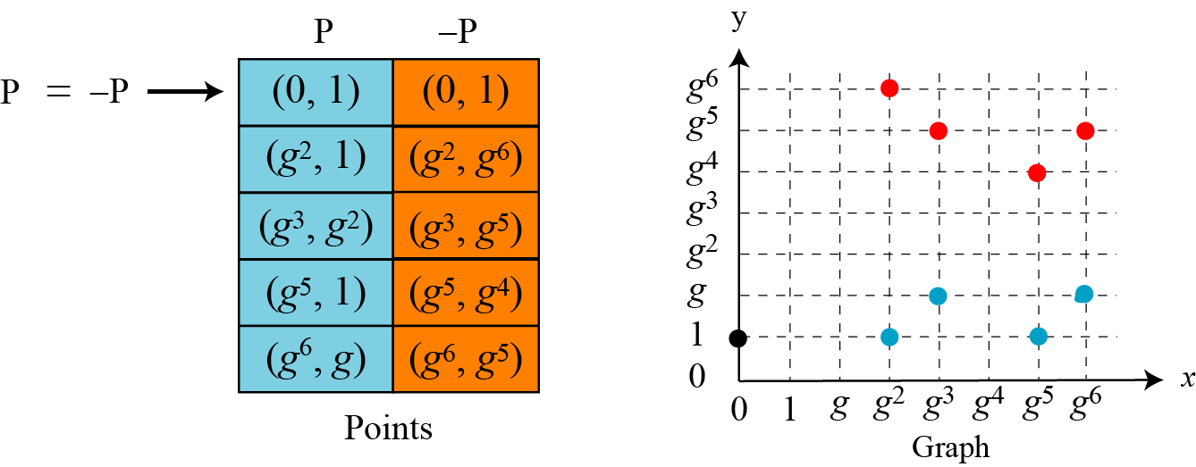
10.5.3 Continued
Example 10. 16
Continued
Using the elliptic curve y² + xy = x³ + g³x² + 1, with a = g³ and
b = 1, we can find the points on this curve, as shown in Figure 10.15..
Figure 10.15 Points on an elliptic curve over GF(2n)
10.<number>

Slide 75


10.5.3 Continued
Adding Two Points
1. If P = (x₁, y₁), Q = (x₂, y₂), Q ≠ −P, and Q ≠ P, then R = (x₃, y₃)
= P + Q can be found as
If Q = P, then R = P + P (or R = 2P) can be found as
10.<number>

Slide 76
10.5.3 Continued
Example 10. 17
Let us find R = P + Q, where P = (0, 1) and Q = (g², 1).
We have λ = 0 and R = (g⁵, g⁴).
Example 10. 18
Let us find R = 2P, where P = (g², 1). We have λ = g² + 1/g²
= g² + g⁵ = g + 1 and R = (g⁶, g⁵).
10.<number>

Slide 77

10.5.4 ECC Simulating ElGamal
Figure 10.16 ElGamal cryptosystem using the elliptic curve
10.<number>

Slide 78

10.5.4 Continued
Generating Public and Private Keys
E(a, b) e₁(x₁, y₁) d e₂(x₂, y₂) = d × e₁(x₁, y₁)
Encryption
Decryption
Note
The security of ECC depends on the difficulty of solving the elliptic curve logarithm problem.
10.<number>

Slide 79
10.5.4 Continued
Example 10. 19
Here is a very trivial example of encipherment using an elliptic
curve over GF(p).
Bob selects E₆₇(2, 3) as the elliptic curve over GF(p).
Bob selects e₁ = (2, 22) and d = 4.
Bob calculates e₂ = (13, 45), where e₂ = d × e₁.
Bob publicly announces the tuple (E, e₁, e₂).
Alice wants to send the plaintext P = (24, 26) to Bob. She selects r = 2.
Alice finds the point C₁= (35,1), where C₁=r × e₁.
10.<number>

Slide 80
10.5.4 Continued…
Alice finds the point C₂=(21,44), where C₂=P+r × e₂
Bob receives C₁ and C_{2 .} He uses 2 × C₁(35,1) to get (23,25)
Bob inverts the point (23,25) to get the point (23, 42)
Bob adds (23,42) with C₂=(21,44) to get the original plaintext P= (24,26)
10.<number>
10.<number>

Slide 81
Security of ECC
The security of ECC depends on the difficulty of solving the Elliptic Curve Discrete Logarithmic Problem (ECDLP).
Value of r and d are secret.
10.<number>

Slide 82
Elliptic Curve Groups over real numbers
QUIZ:
1. Does the elliptic curve equation y² = x³ - 7x - 6 over real numbers define a group?
2. What is the additive identity of regular integers?
3. Is (4,7) a point on the elliptic curve y² = x³ - 5x + 5 over real numbers?
4. What are the negatives of the following elliptic curve points over real numbers?
P(-4,-6), Q(17,0), R(3,9), S(0,-4)
5. In the elliptic curve group defined by y² = x³ - 17x + 16 over real numbers, what is P + Q if P = (0,-4) and Q = (1,0)?
6. In the elliptic curve group defined by y² = x³ - 17x + 16 over real numbers, what is 2P if P = (4, 3.464)?
10.<number>

Slide 83
QUIZ ~ Solutions
1. Does the elliptic curve equation y²= x³- 7x - 6 over real numbers define a group?
Yes, since 4a³+ 27b²= 4(-7)³+ 27(-6)²= -400
The equation y²= x³- 7x - 6 does define an elliptic curve group because 4a³+ 27b²is not 0.
2. What is the additive identity of regular integers?
The additive identity of regular integers is 0, since x + 0 = x for all integers.
3. Is (4,7) a point on the elliptic curve y²= x³- 5x + 5 over real numbers?
Yes, since the equation holds true for x = 4 and y = 7:
(7)²= (4)³- 5(4) + 5
49 = 64 - 20 + 5
49 = 49
10.<number>

Slide 84
4. What are the negatives of the following elliptic curve points over real numbers?
P(-4,-6), Q(17,0), R(3,9), S(0,-4)
The negative is the point reflected through the x-axis. Thus
-P(-4,6), -Q(17,0), -R(3,-9), -S(0,4)
5. In the elliptic curve group defined by y²= x³- 17x + 16 over real numbers, what is P + Q if P = (0,-4) and Q = (1,0)?
From the Addition formulae:
s = (y_{P}- y_{Q}) / (x_{P}- x_{Q}) = (-4 - 0) / (0 - 1) = 4
x_{R}= s²- x_{P}- x_{Q}= 16 - 0 - 1 = 15
and
y_{R}= -y_{P}+ s(x_{P}- x_{R}) = 4 + 4(0 - 15) = -56
Thus P + Q = (15, -56)
10.<number>

Slide 85
6. In the elliptic curve group defined by y²= x³- 17x + 16 over real numbers, what is 2P if P = (4, 3.464)?
From the Doubling formulae:
s = (3x_{P}²+ a) / (2y_{P}) = (3*(4)²+ (-17)) / 2*(3.464) = 31 / 6.928 = 4.475
x_{R}= s²- 2x_{P}= (4.475)²- 2(4) = 20.022 - 8 = 12.022
and
y_{R}= -y_{P}+ s(x_{P}- x_{R}) = -3.464 + 4.475(4 - 12.022) = - 3.464 - 35.898 = -39.362
Thus 2P = (12.022, -39.362)
10.<number>

